Slide 1
COVID-19
Social Distancing
Malahide
New Street & The Mall
May 2020

Slide 2


Slide 3
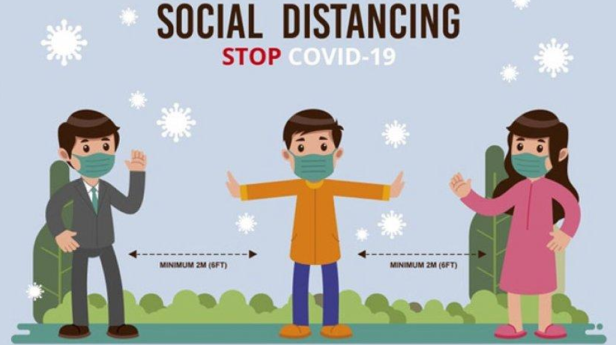
Current Challenges
Fingal County Council acknowledges the changing needs of its communities during the Covid-19 pandemic by assessing and repurposing public road space to facilitate the increase in cyclists and pedestrians by giving them extra space to practice social distancing from each other.
During a needs assessment, it was determined that vehicular traffic on the roads has fallen nearly 70% with a corresponding fall in public transport use by 95% since the commencement of the Covid-19 restrictions.

Slide 4
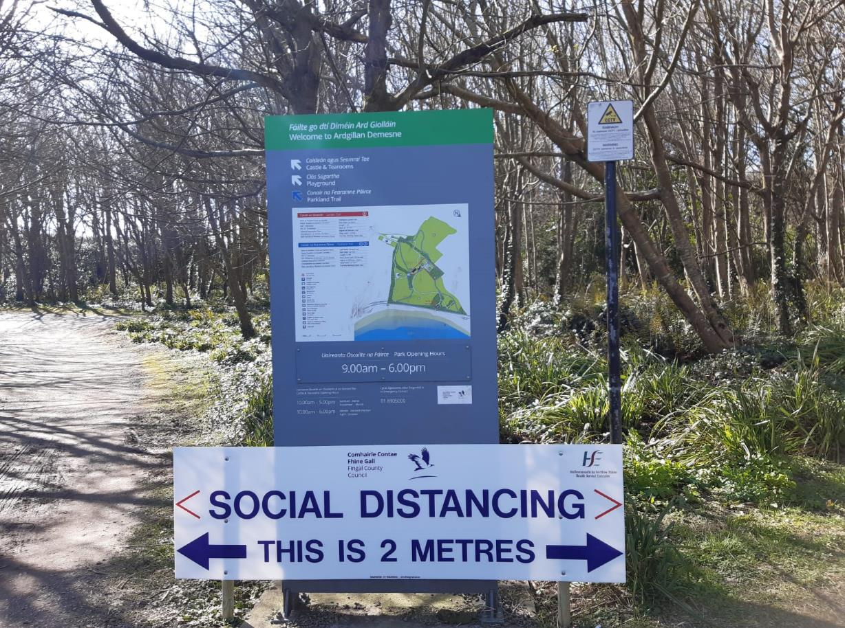
Current Challenges
Increased number of pedestrians, joggers and cyclists on footpaths and roads
Limited footpath space - difficult for people to adhere to social distancing of 2 metres
Wheelchair & buggies have less space to adhere to social distancing on busy footpaths
People stepping out onto the road into traffic
383% Increase in number of cyclists using Bleeper bikes
Queueing outside shops/premises reducing available footpath space.

Slide 5
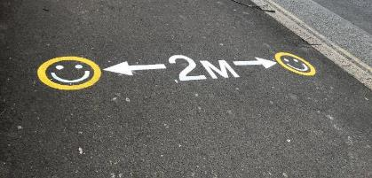
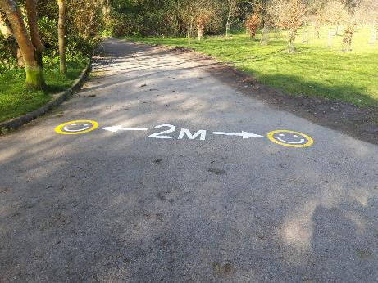
What is our aim?
To provide a safe space and environment for pedestrians, joggers, cyclists, wheelchair users and people with buggies on busy footpaths and roads
Helping members of the public to adhere to social distancing measures
Notes:
Image: https://www.theguardian.com/teacher-network/teacher-blog/2014/aug/28/rise-of-cycle-school-generation

Slide 6
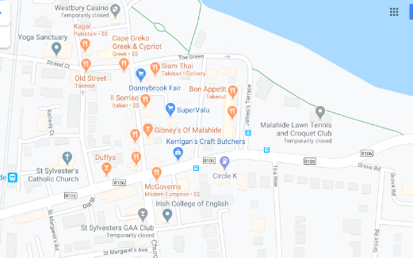
What we plan to do
Remove the parking bays c.50 metres for pedestrian use on the R106 the Mall, Malahide. This will allow shoppers sufficient space for queuing and pedestrians sufficient space to walk by
Location
Notes:
Image: https://www.880cities.org/lessons-from-the-school-streets-movement-taking-off-in-europe/
Image: https://www.myurbancar.com/2019/03/28/school-streets-in-london/

Slide 7
Widen footpath into parking bays on The Mall
Using parking bays along the Mall between New St. and Townyard Lane
Notes:
https://pixabay.com/illustrations/cartoon-school-road-2898150/
Image: https://www.vectorstock.com/royalty-free-vector/bike-icon-vector-10772875
Image: https://www.flaticon.com/free-icon/scooter_130059

Slide 8
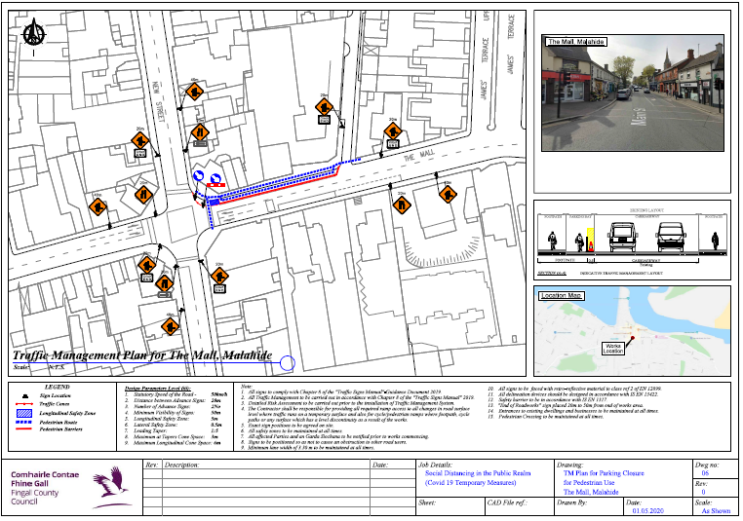

Slide 9
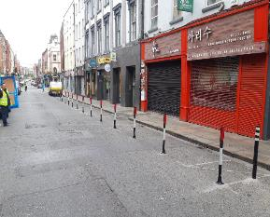
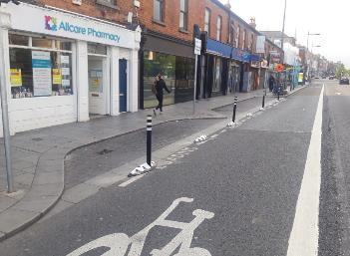
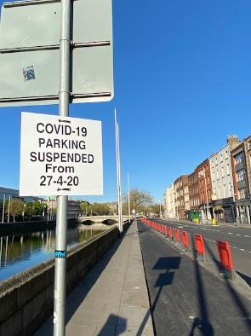
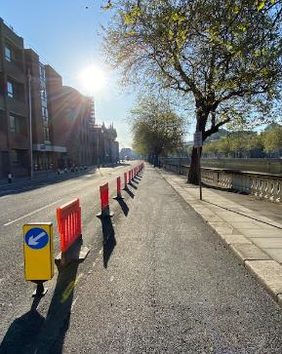
DCC Examples

Slide 10
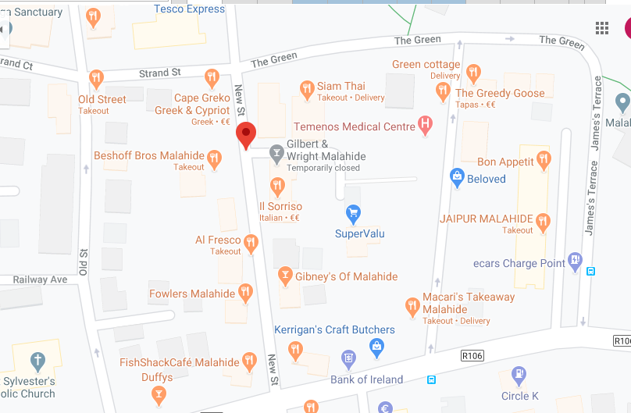

Pedestrianise New Street
Pedestrianise New Street, c.150m to facilitate and encourage social distancing.
Vehicular access to remain for emergency services, deliveries and residents
Location

Slide 11
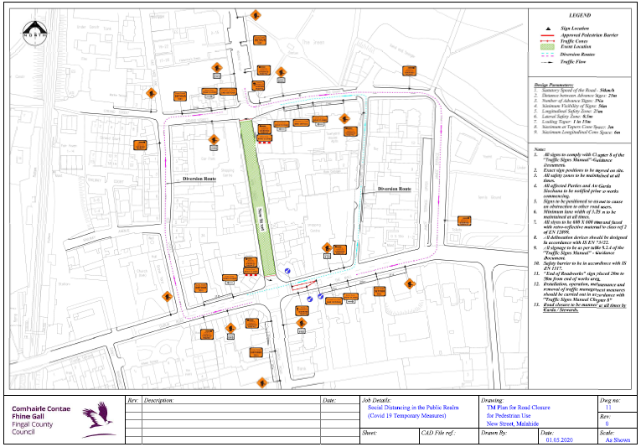

Slide 12
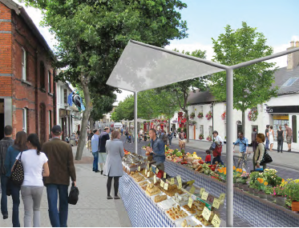
We Know we can do this!
A Safe Space for Shoppers
A place for: retailers/cafes/restaurants/ bars to expand their business into the street

Slide 13
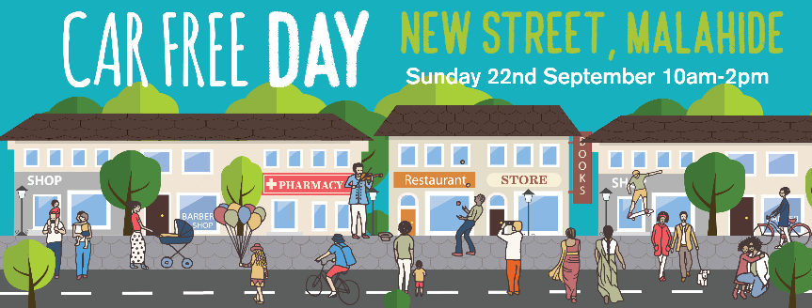
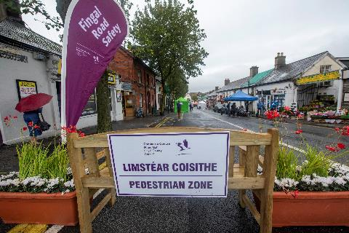
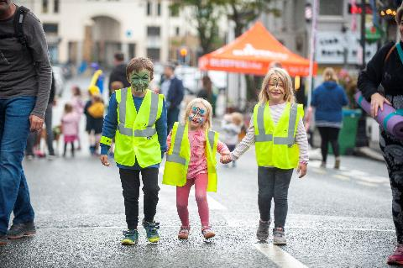

Slide 14
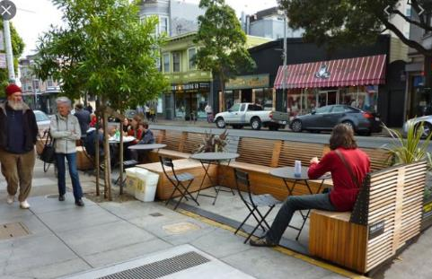
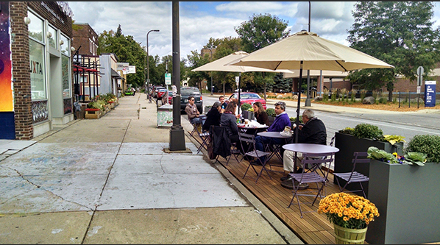
Examples of public realm solutions in place of parking spaces

Slide 15
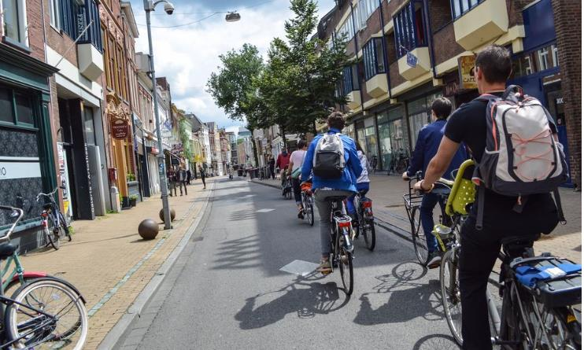
Dutch Example

Slide 16
UK Evidence

Slide 17
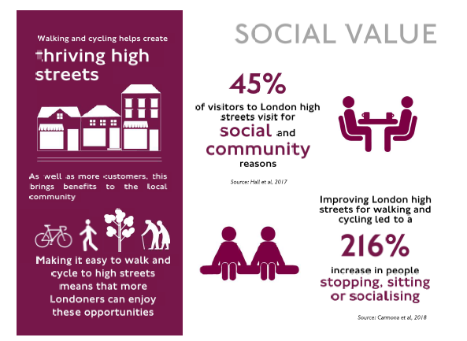
UK Evidence

Slide 18
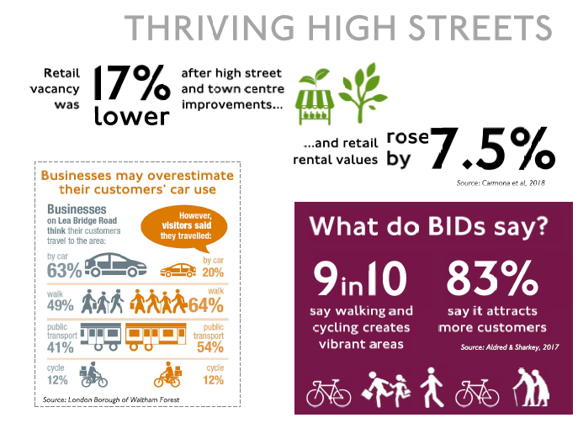

Slide 19
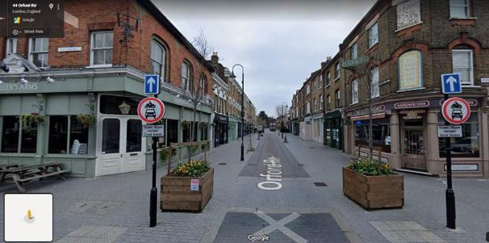
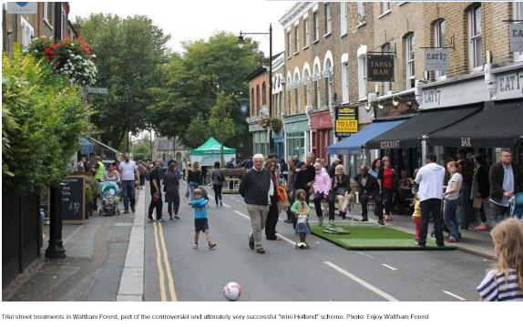
Examples from equivalent locations Mini Holland London – Orford Road

Slide 20
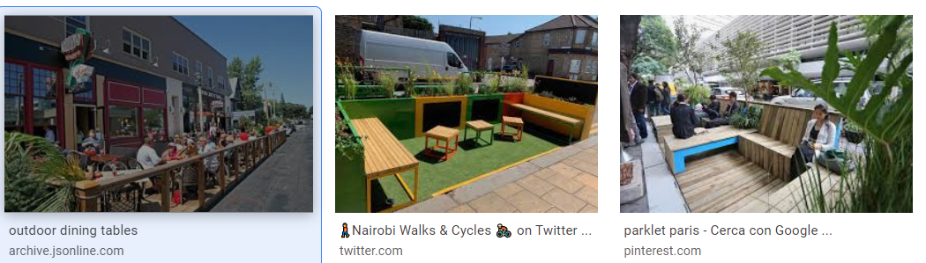
Examples of public realm solutions in place of parking spaces

Slide 21
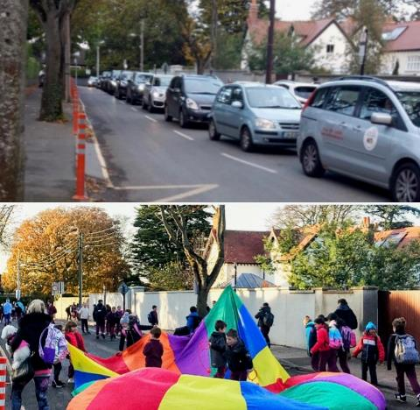
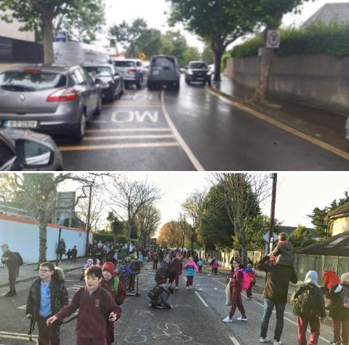
We can do things like this!

Slide 22
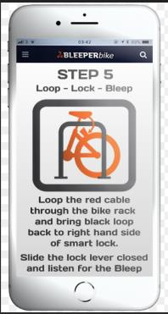
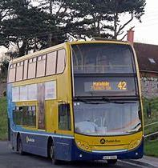
Alternative Modes of Travel Bleeper Bikes & Dublin Bus

Slide 23
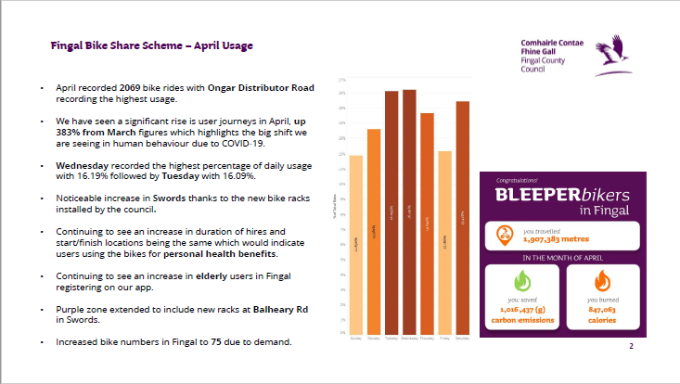
Bleeper Bikes Usage during Covid 19

Slide 24
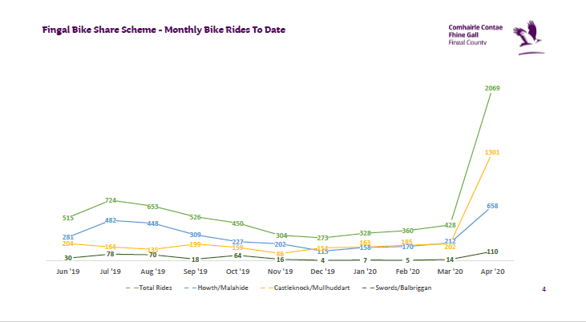
Bleeper Bikes Usage during Covid 19

Slide 25
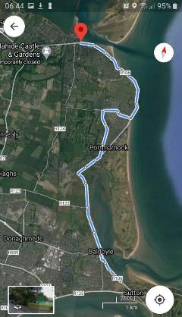
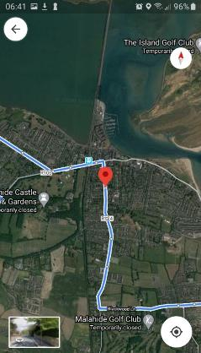
Dublin Bus Routes Malahide #32 & #42
#32
#42

Slide 26
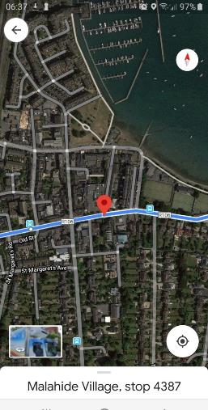
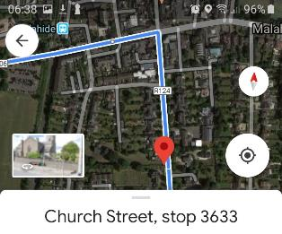
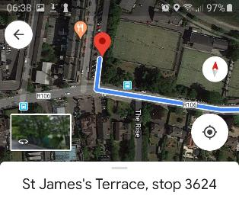
Dublin Bus Stops Malahide Village

Slide 27
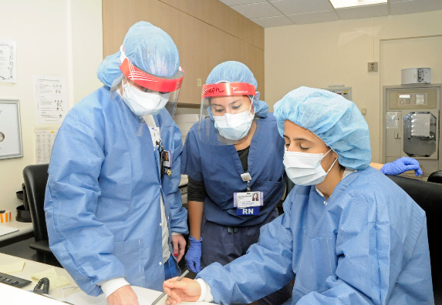
Concerns Raised by CoC
Issue:
Temporary Measures & Return to normal arrangements
Loading Bay
Disabled Parking spaces
Access to Rosses cottages
New Electric Car spaces
Cycleway congregation
Taxis to be permitted back after 7pm
Parking & Bridgefield CP & signage
Junction of James’ Terrace and the Mall
Bend at Yacht Club
Response:
Dependant on Govt Announcements
Loading will be accommodated before 10am
Disabled Parking spaces to be provided on the Mall and the Green
Access to Rosses cottages to be maintained
New Electric Car space to be closed after 10am
It is not intended to be a through route for cyclists, but a slow moving environment for cyclists and pedestrians
Taxis will be accommodated on the Mall at the Tennis Club
Bridgefield CP to be reopened, signage to be considered
James’ Terrace/The Mall junction to be monitored following implementation
Bend and Ped movement to be reviewed on site

Slide 28

Concerns Raised by Malahide Forum
Issue:
General support among residents for the initiatives
Residents concerns In the area of the Marina, where social distancing has been severely restricted and reduced by the hoarding erected around the Village Green
Consider the northern side of Main Street, from the junction with Old Street to The Diamond, where the footpath is very narrow
Access for: Disability permit holders & New Street residents
Residents are very interested to know how New Street will be closed off - with a preference expressed for the use of attractive planters.
Response:
Noted
Works to recommence on the Green to keep project on time
Issues here with left turning and right turning manoeuvres at the Diamond. To be assessed following implementation
Disabled spaces to be provided on the Green and the Mall
Initially TTM measures: following assessment, more aesthetic measures being considered such as benches, planters, parklets

Slide 29
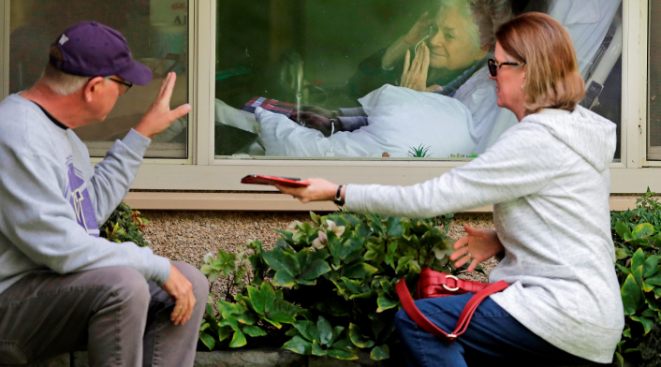
Summary & Review
Fingal County Council seeks to encourage physical activity at a safe social distance and thereby improving the physical and mental health of its’ citizens during this time of restricted movement.
These measures are being introduced by Fingal County Council in consultation with local Gardai and meeting with local stakeholders
These measures will be closely monitored by engineers and reviewed at intervals as the Government restrictions change

