Slide 1
Operations Department
ACM - Covid 19 Response
Eamon Lynch 20th May 2020

Slide 2
Pandemic Planning – Initial Stages
Identification of Critical Services
Litter and Cleansing Services
Management of Burial Grounds
Responding to identified emergencies
Provision and maintenance of public lighting
Provisions and maintenance of traffic signals
Provisions and maintenance of public open space
Road opening licences and management of wayleaves

Slide 3
Operations Department - Covid 19 Response
Pandemic Planning
Staff Management
Physical Distancing in offices and depots
Flexible working hours for staff where possible
Regular and ongoing sanitisation of all Council vehicles and depots
Remote working where possible
Roll out of laptops to critical staff
Signage and hand sanitisers in depots and offices

Slide 4
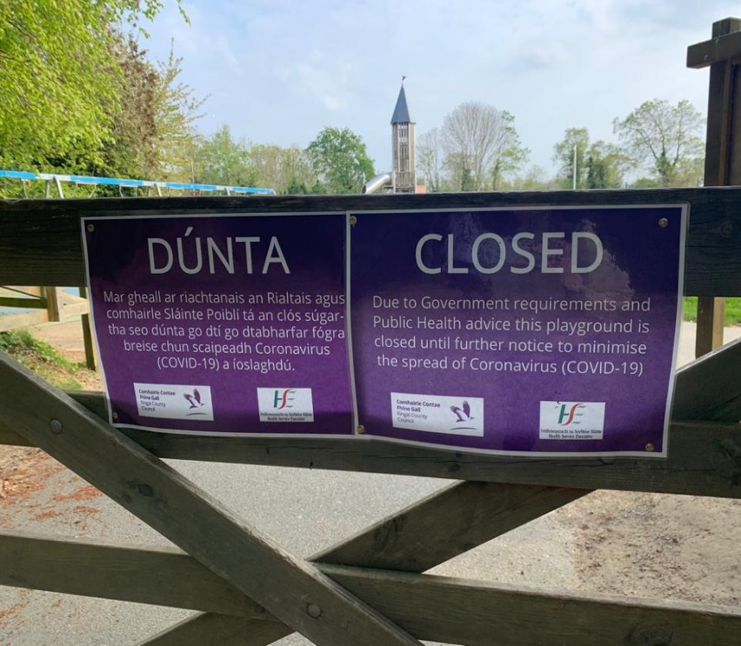
Operations Department - Covid 19 Response
Closure of all playgrounds, outdoor exercise equipment, MUGAs etc
Car parks in regional parks and beaches closed from the 28th March 2020
Emergency cover provided during working day for designated non-critical services
Additional fleet vehicles hired to ensure safety of staff.

Slide 5
Operations Department - Covid 19 Response
Physical distancing signage in parks, open spaces and public footpaths
Additional rangers service in key parks and open spaces at request from Gardai
Rangers acting as a visible presence reminding members of the public on the need to maintain physical distancing
Grass cutting in regional parks, open spaces continues.

Slide 6
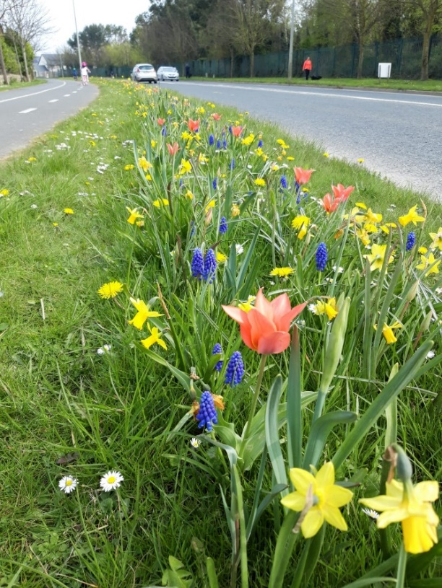
Operations Department - Covid 19 Response
Operational Area | Complaints Received Since 1st of March 2020
Balbriggan, Rush, Lusk, Swords | 849
Castleknock, Mulhuddart | 656
Howth, Malahide | 415

Slide 7
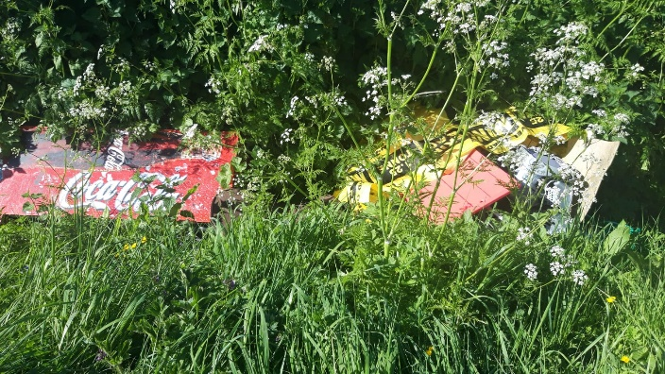
Operations Department - Covid 19 Response
Increase in littering observed generally
Increased levels in dog fouling observed.
Small number of blackspot areas with increased dumping.
Messaging being pushed out by Communications to increase public awareness and to report littering
National Media Campaign

Slide 8
Operations Department - Covid 19 Response

Slide 9
Operations Department - Covid 19 Response
Management of burial grounds
Significant increase in burials across the County

