Slide 1
Walk Bike Fingal!
Plan for Social Distancing in the Public Realm
(Covid-19 Temporary Measures)
Presenter: Andrew Nolan – Operations Dept. – Traffic Section
Howth-Malahide ACM 20th May 2020

Slide 2
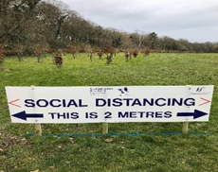
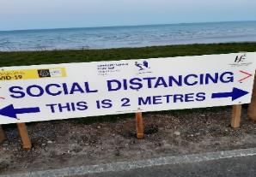
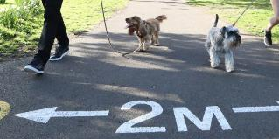
Fingal County Council during Covid-19 Restrictions
Fingal seeks to encourage physical activity at a safe social distance and thereby improving the physical and mental health of its citizens during this time of restricted movements.

Slide 3
Background – Why was This Required
During Covid-19 restrictions - Vehicular traffic decreased and pedestrians & cyclists increased
Some people walking and exercising on busy and sometimes crowded footpaths are moving out into the road to preserve the required 2m social distance.
Others, especially if walking with children are staying on the footpath but passing others at less than the 2m required distance and thereby risking infection rather than risking injury from vehicular traffic.
All of these raise new road safety issues
not experienced before to this extent.

Slide 4
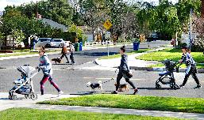
Background to ‘Walk Bike Fingal!’ the Plan
FCC acknowledged the changing needs of its communities & Engineers carried out a needs assessment at sites across the whole Fingal county
Solution: to temporarily repurpose roads, streets and public realm spaces to facilitate social distancing
Aim: to provide residents with safe space to walk, run, exercise and travel by bike and adhere to the 2m rule.
Temporary Measures: are being introduced by Fingal in consultation with Local Gardai.

Slide 5
Plan Approved by Corporate Policy Group

Slide 6
Several classes of measures (some listed below)
Removal of parking and loading bays to increase footpath widths especially outside busy essential shops to reduce congestion
Temporary closure of sections of bus lanes to widen footpaths
Increasing footpath widths using infrastructure placed in the roadway
Introduction of pedestrianised locations whilst maintaining motor vehicle access for residents, deliveries and emergency responders
Introduction of one way systems, including the introduction of a temporary extra lane for walking and cycling where suitable
Implementation of temporary cycle lanes
Reallocation of traffic lanes for use by pedestrians and cyclists

Slide 7
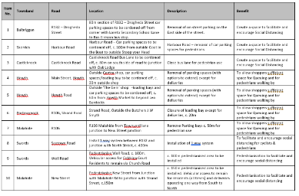
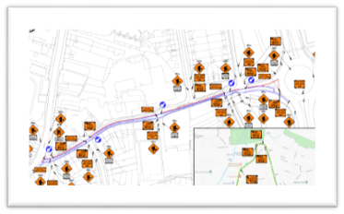
‘Walk Bike Fingal!’ the Plan
Engineers identified a list of over 25 locations where measures could be introduced.
8 initial locations were selected and 10 are being progressed to full design with associated Traffic Management plans to implement the measures

Slide 8
Howth - Malahide
Initial Locations
Details & Maps

Slide 9
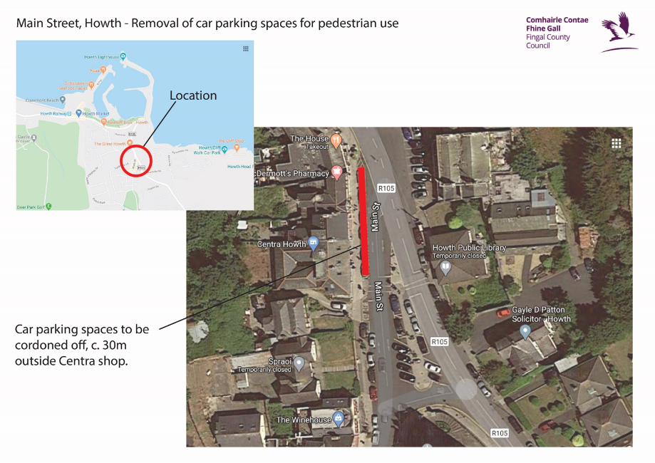
1. Howth – Main Street

Slide 10
2. Howth – Howth Road

Slide 11
3. Malahide – R106 (The Mall)

Slide 12
4. Portmarnock – Strand Road

Slide 13
5. Malahide – New Street

Slide 14
Current Implementation Plan & Next Steps
Engineers are currently working on finalising the Traffic Management Plan designs which are required in order to implement these measures at the 10 initial locations.
It is hoped that the first of these measures will begin to be put in place in the coming fortnight.
These locations will be monitored and maintained whilst in place. The measures at these and further locations will be adjusted as Government restrictions & Health Guidance changes
Vast numbers of correspondence, regarding suggestions for further locations, has been received. These are being added to a list for further consideration.

