Slide 1
Burrow beach 2026

Slide 2
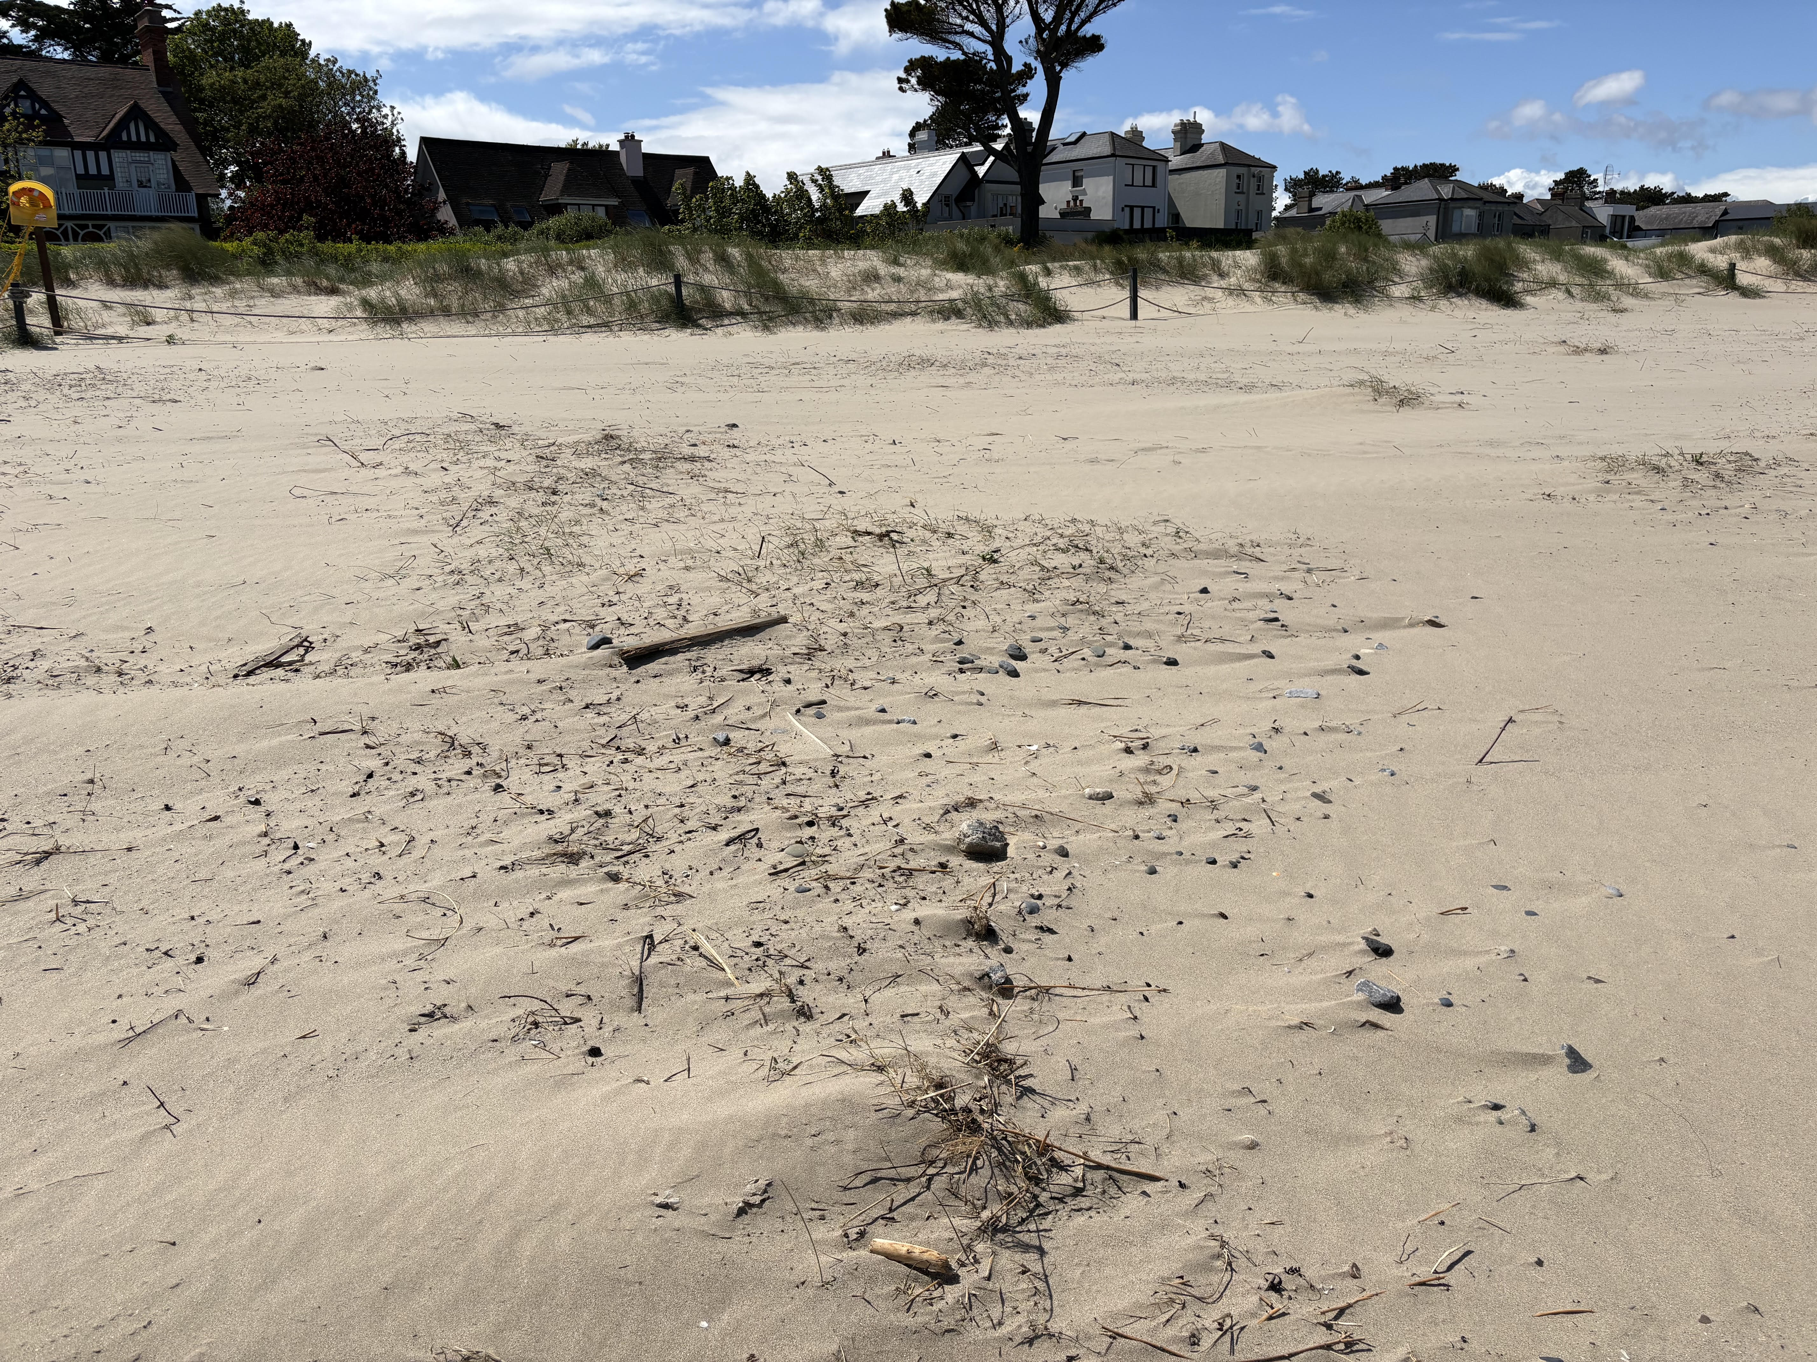
Burrow Beach early May 2026

Slide 3
Burrow Beach early May 2026

Slide 4
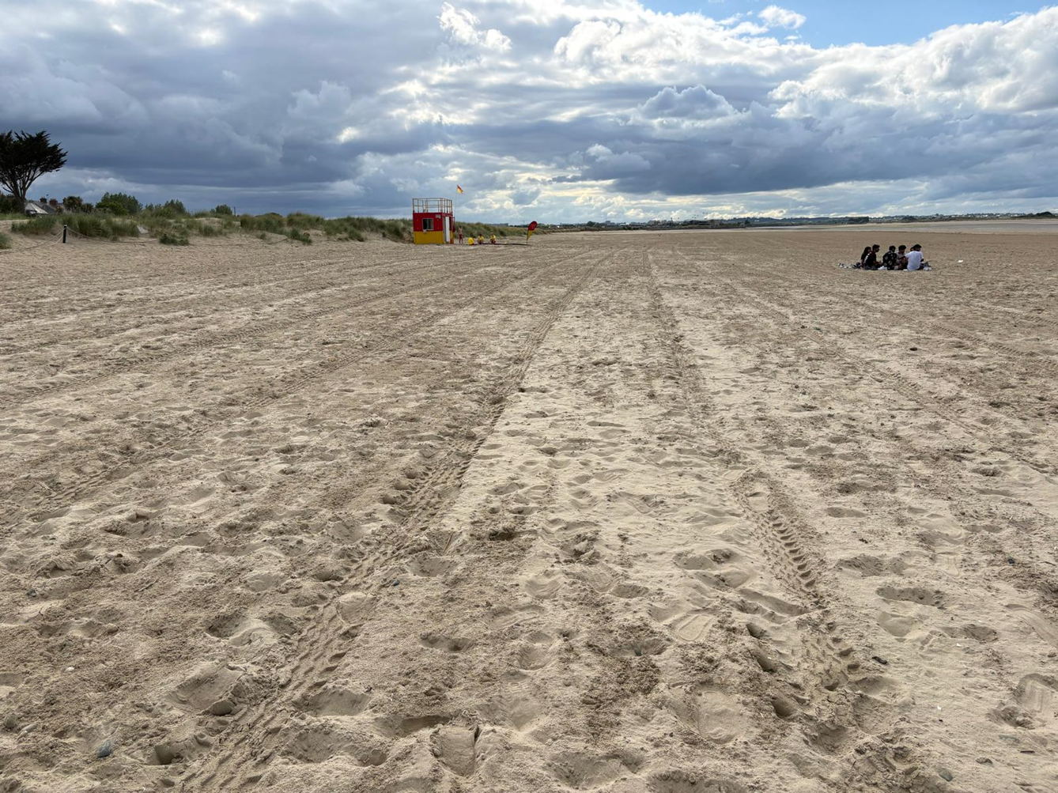
Burrow Beach late May 2026

Slide 5
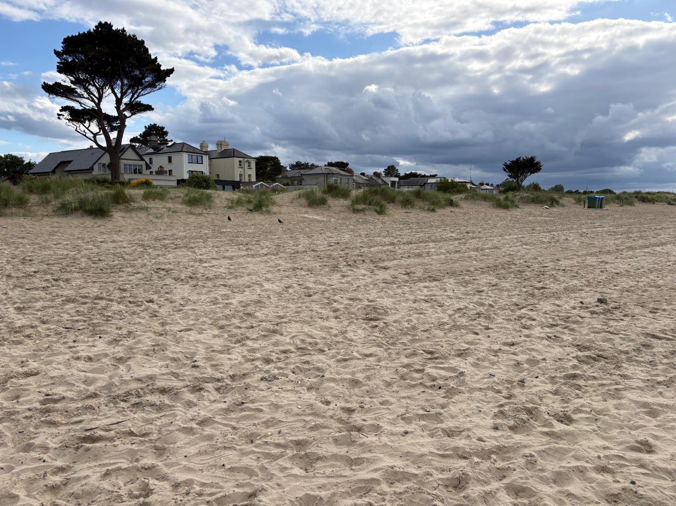
Burrow Beach late May 2026

Slide 6
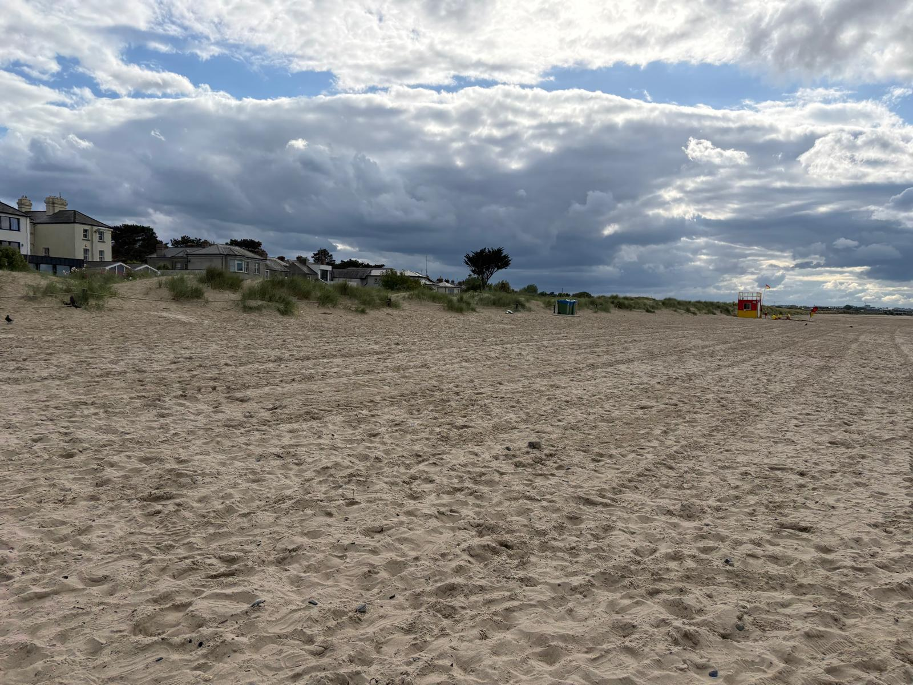
Burrow Beach late May 2026

